Slide 1

Building .NET Applications with
Presented By: Chris Berthold github.com/cberthold
twitter.com/chrisberthold

Slide 2


Slide 3
Chris Berthold : Your presenter
Over 20 years of development experience crafting and engineering software plus DevOps/network administration
10 years of business development in a manufacturing setting
6 years of development as software consultant
Private pilot
Nearly 10 years with the awesome Product Development Team for Flightdocs
Enjoys software architecture, simplifying software design and practical performance in applications, and engaging others in software architecture
http://github.com/cberthold/presentations

Slide 4

Agenda
Exercise brain
Demo Docker Compose
Demo First .NET Application in Docker Compose and Debug
Demo solving a cloud problem using .NET and Docker Compose
Panic – you ran out of time
Questions & Answers

Slide 5

Ground Rules
Keep questions to end of each section
Hopefully I will explain it before then
Try to only ask questions about the topic (Docker Compose)
If you have specific business use cases we can talk afterwards
We’re all here to learn and we want to use the time wisely
If you plan on throwing anything, please throw money.

Slide 6
Brain Exercise
Question: A man was moving to a new house. He rented a moving truck, put all his belongings in it, and drove to his new place. He entered the garage with the truck and took all his belongings out of the truck. When he tried to exit the garage with the truck, he couldn’t. Why?

Slide 7
Brain Exercise
Question: A man was moving to a new house. He rented a moving truck, put all his belongings in it, and drove to his new place. He entered the garage with the truck and took all his belongings out of the truck. When he tried to exit the garage with the truck, he couldn’t. Why?
Answer: The empty truck was just slightly taller than the garage door. When it was packed with items, the truck’s height got lower, so the man could enter the garage. Once the items were unpacked, the truck was once again taller than door, so it couldn’t get out.

Slide 8

What is Docker Compose?
Docker Compose allows you to define and run multiple-container Docker environments. You’re able to configure your application services in a Compose file, and then start and stop all services from this configuration file.
Compose uses YAML (YAML Ain’t Markup Language), a human-friendly data serialization standard, for its configuration file format.

Slide 9
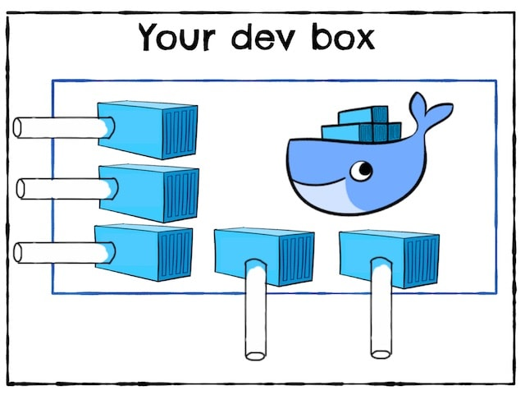
Why use Docker Compose?
Compose allows you to:
Create multiple isolated environments on a single host
Preserve volume data when creating containers
Re-create containers that have been updated
Use variables and move compositions between environments
What are the real benefits?
Create isolated environments in code and checked-in
Enables zero-installation (with exception to Docker) of any software
Extremely low barrier to entry to for recreating environments

Slide 10
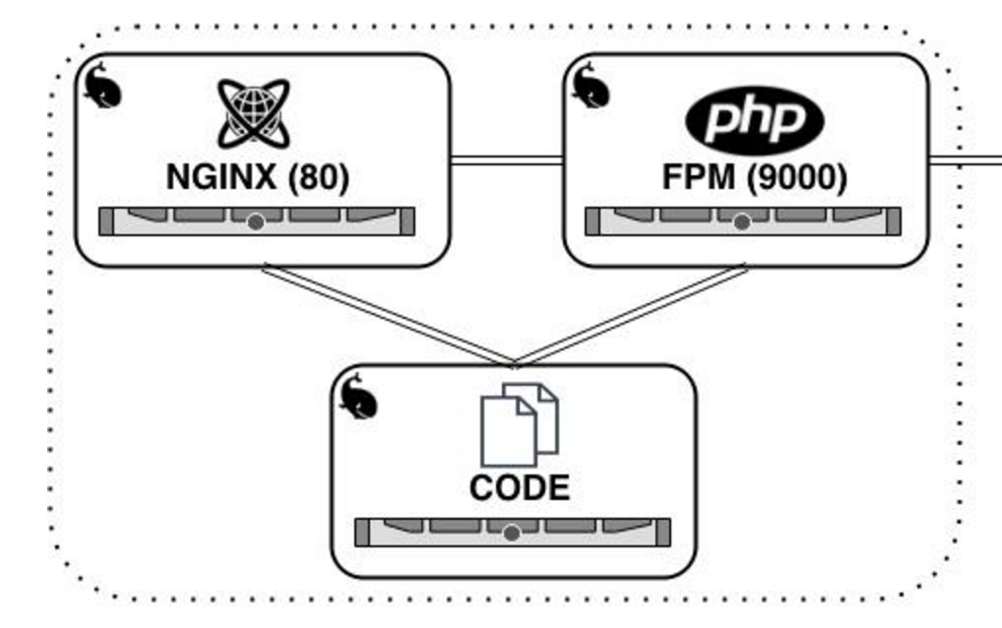
Demo #1 Docker Compose
NGINX – Load Balancer
PHP – Application
Both running on Linux

Slide 11
Demo #2 Compose and .NET
Build a .NET Web API
Dockerize it
Compose it
Debug it in a container

Slide 12
Demo #2 Extended Solve a Cloud problem with all of it
NGINX
.NET API

Slide 13
Demo #2 Extended Solve a Cloud problem with all of it
NGINX
.NET API
.NET API

Slide 14

Questions and Answers

Slide 15

Thank You

